Slide 1
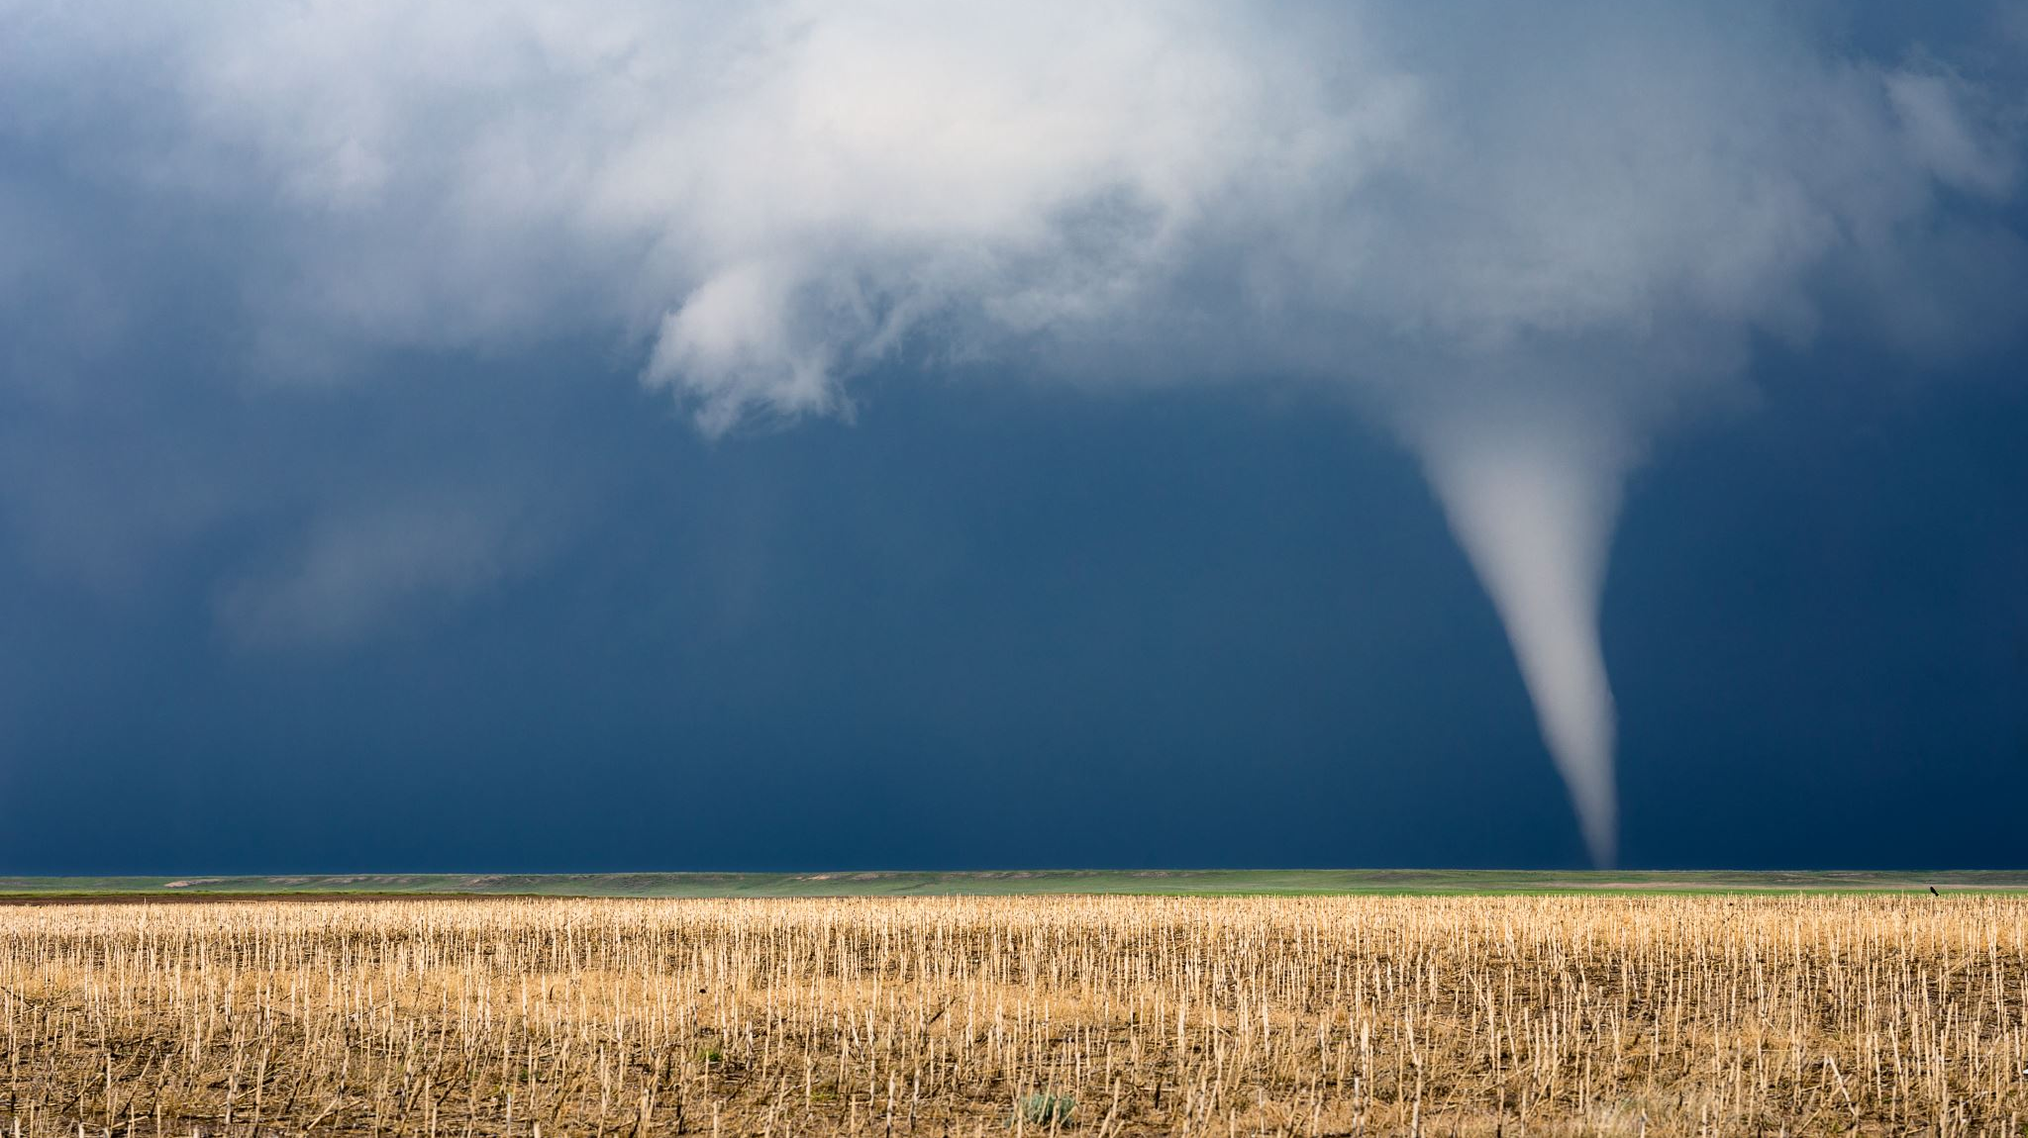
Smart Irrigation System
190040015 – A.V Bindu Bhargav
190040025 -A. Devi Supraja
190040030 – Rishitha Anumolu

Slide 2
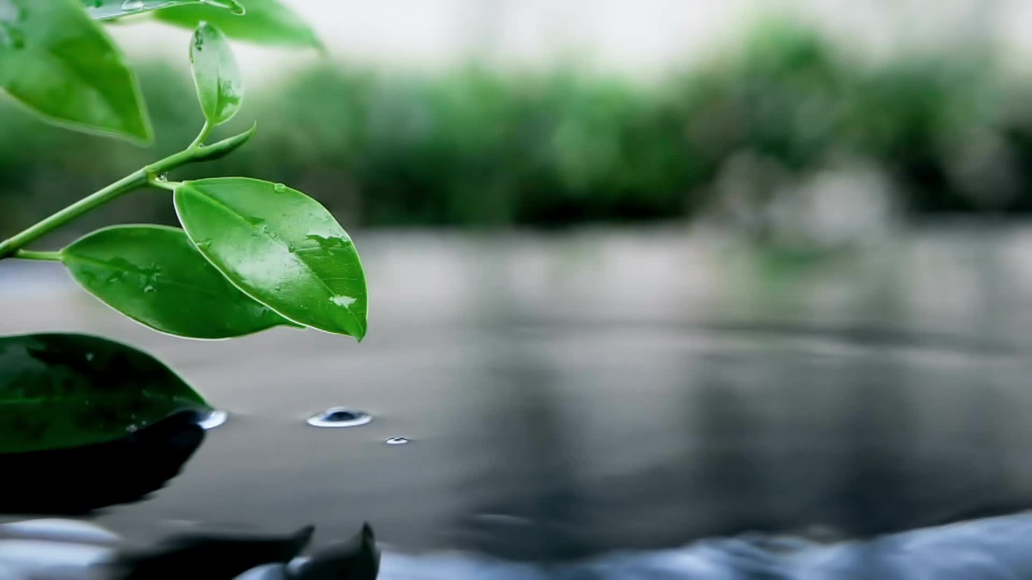
Abstract
As water supply is becoming scarce in today’s world there is an urgency of adopting smart ways of irrigation.
The project describes how irrigation can be handled smartly using IOT.
This project aims at saving time and avoiding problems like constant vigilance. It also helps in conserving water by automatically providing water to the plants/field depending on the water requirements.
Also, about environmental conditions, like temperature, humidity, pressure, rain level.
This system can also prove to be helpful in agriculture, parks and lawns.
The objective of this system is to detect the moisture content of the soil and depending on it sprinkle water .This entire information will be sent to the user’s cell phone and in cloud.

Slide 3
Components using….
ESP32 Wroom Module
DHT11 Sensor
Rain Sensor
Soil Moisture Sensor
LDR Sensor
Relay
A DC Motor
Connecting Wires
Bread Board
Cloud Platform Used: Thing Speak Web

Slide 4
Block Diagram
Power Supply
Cloud
Thing Speak
DHT11
ESP32
Wroom Module
Rain Sensor
Relay
DC
Motor
LDR
Relay 2
DC
Motor 2
Soil Sensor

Slide 5
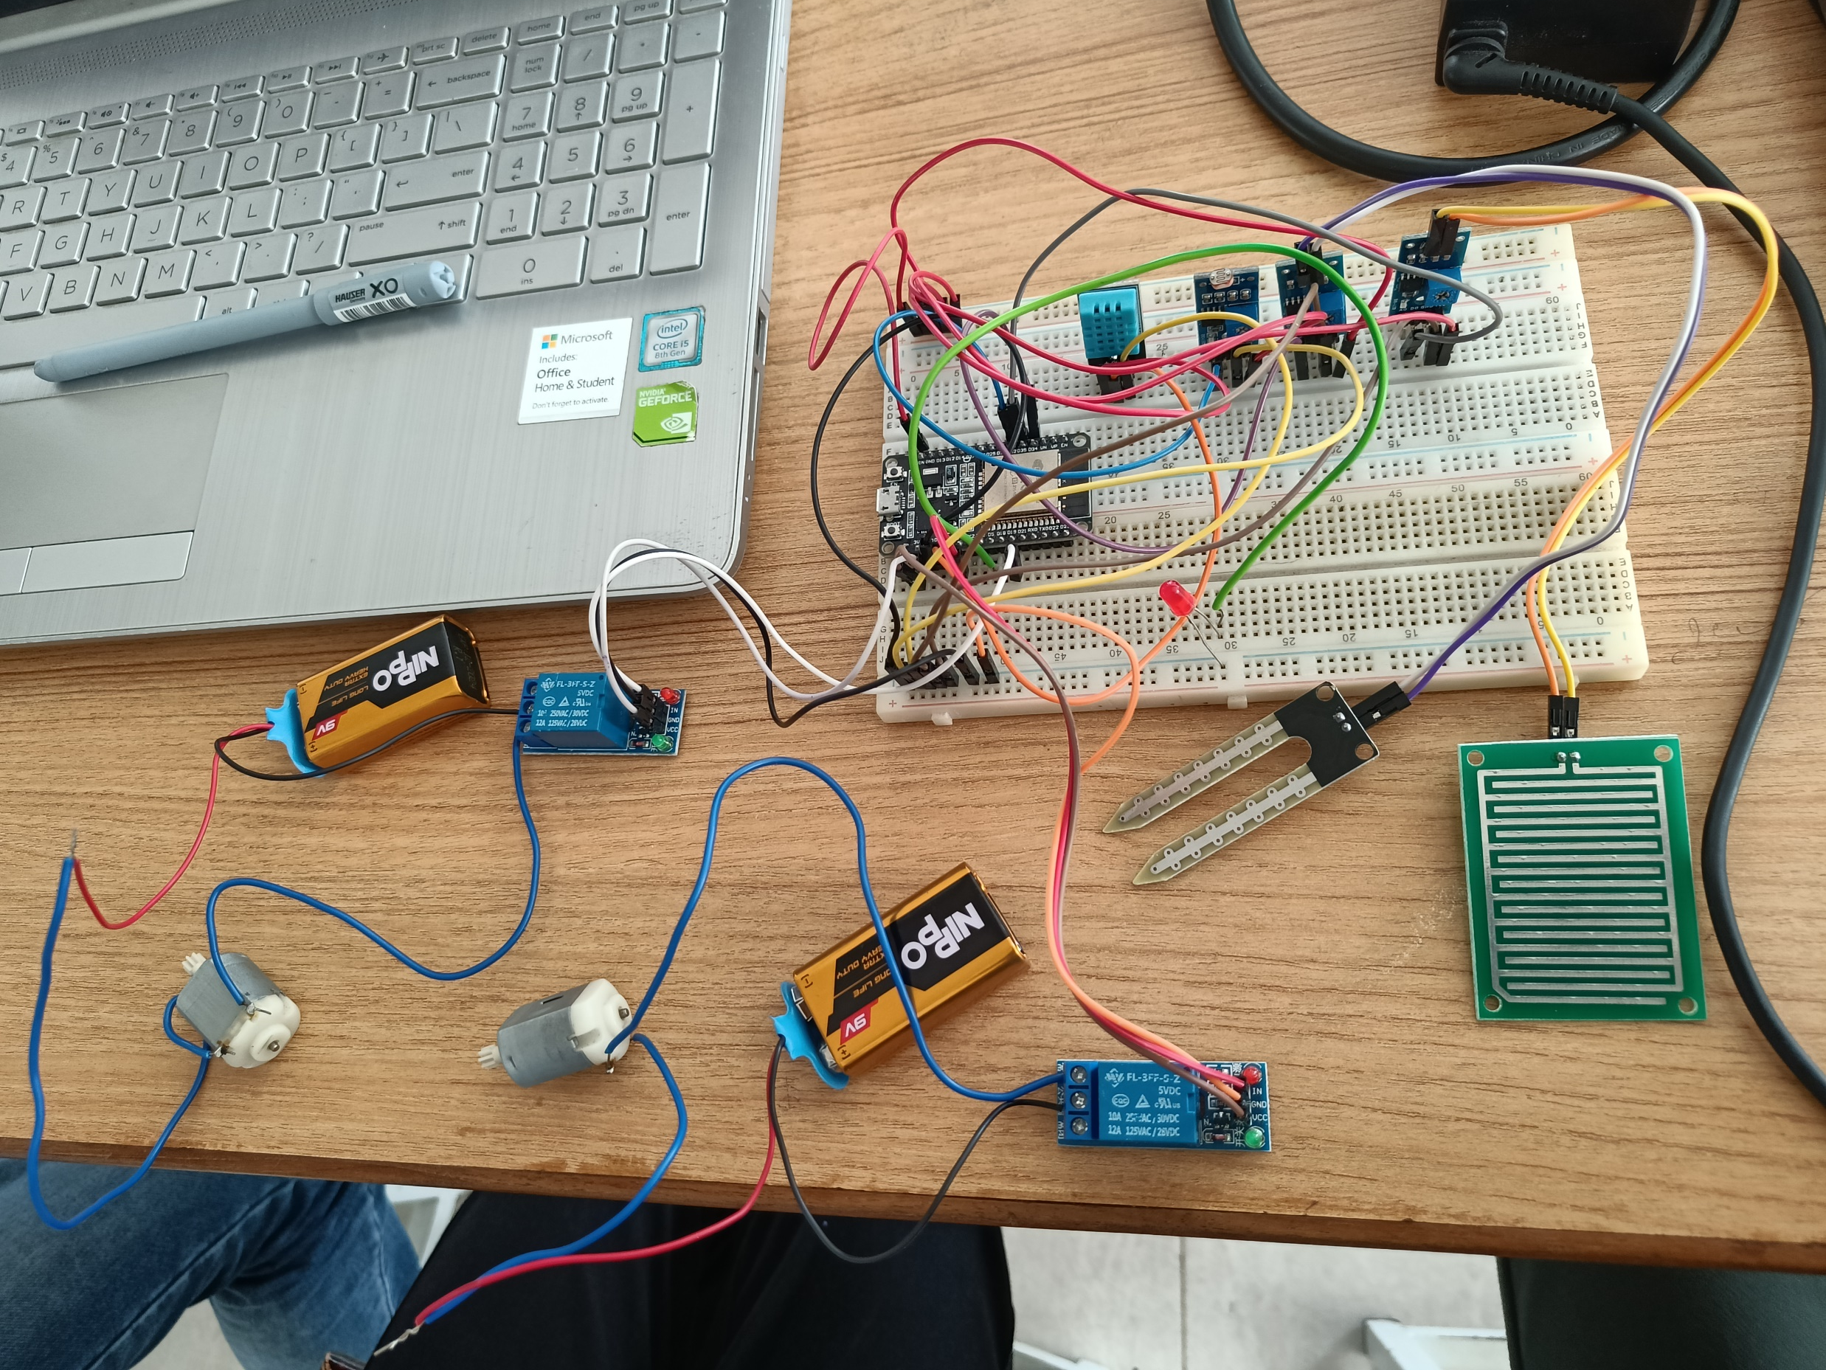
Hardware

Slide 6
Advantages
Do watering
The system will be installed under the ground
It is a drip type
This irrigation system will stop when it rains
Easy to use
Capable of communicating through internet

Slide 7
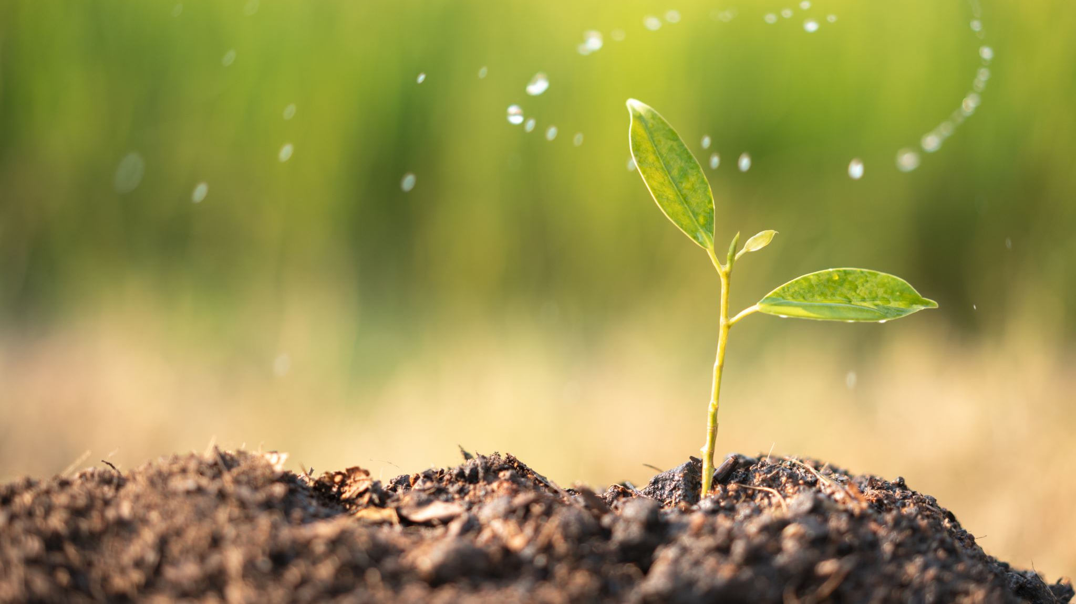
Disadvantages
smart watering system is a bit expensive. Depending on the size of your property, you will need more systems. Of course, saving on water bills will lead to less cost.
If you want to use this system for lawn watering, it’s better to fix it under the ground before planting. Because some parts of the lawn will be harm because of holing.
This rain, soil sensor may start corrosion because of ph levels of soil.

Slide 8
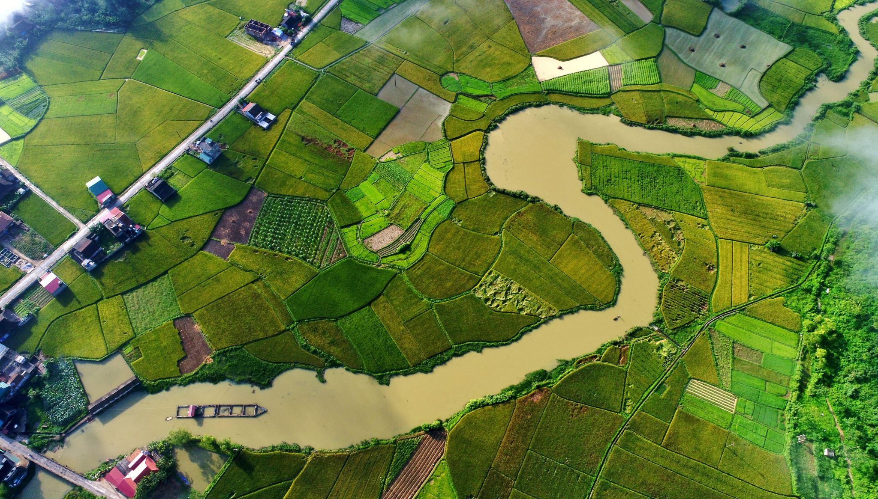
Conclusion
Through this project it can be concluded that there can be considerable development in irrigation with those of IOT and automation.
Thus, this system is a solution to the problems faced in the existing process of irrigation.

